Slide 1


Object Oriented Programming with JAVA
Computer Science & Engineering

Slide 2


UNIT-7
String , Packages and InterFaces

Slide 3
String
A string is a collection of characters. In Java, a string is an object that represents a collection of objects. A string is a predefined class used to create string objects. It is an immutable object, which means it can’t be updated once created.
The string class has a set of built-in-methods, defined below.
charAt(): It returns a character at a specified position.
equals(): It compares the two given strings and returns a Boolean, that is, True or False.
concat(): Appends one string to the end of another.
length(): Returns the length of a specified string.
toLowerCase(): Converts the string to lowercase letters.
toUpperCase(): Converts the string to uppercase letters.
indexOf(): Returns the first found position of a character.
substring(): Extracts the substring based on index values, passed as an argument.

Slide 4
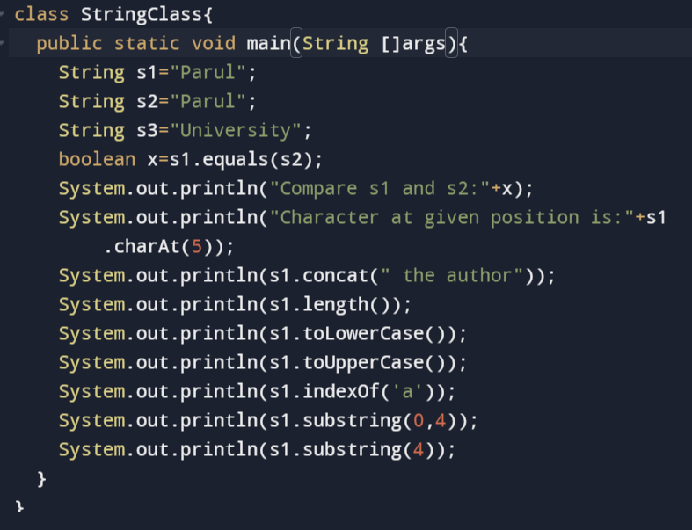
Example of String Functions

Slide 5
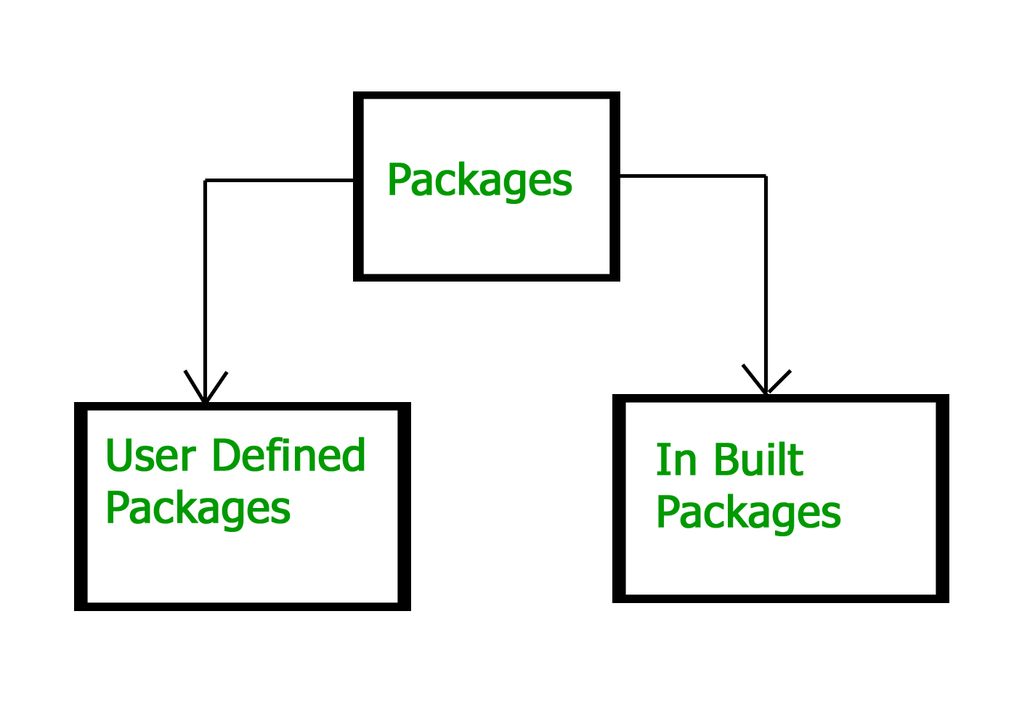
Contents
Packages
Packages in Java serve as a container for organizing classes, interfaces, and sub-packages with similar functionalities.
These packages fall into two categories:

Slide 6
Types of Packages
Built-in packages: Built-in packages is also known as pre-defined packages and these packages contain large numbers of classes and interfaces that we used in java are known as Built-in packages.
User-defined packages: As the name suggests user-defined packages are a package that is defined by the user or programmer.

Slide 7
Advantage of Java Package
1) Java package is used to categorize the classes and interfaces so that they can be easily maintained.
2) Java package provides access protection.
3) Java package removes naming collision.

Slide 8
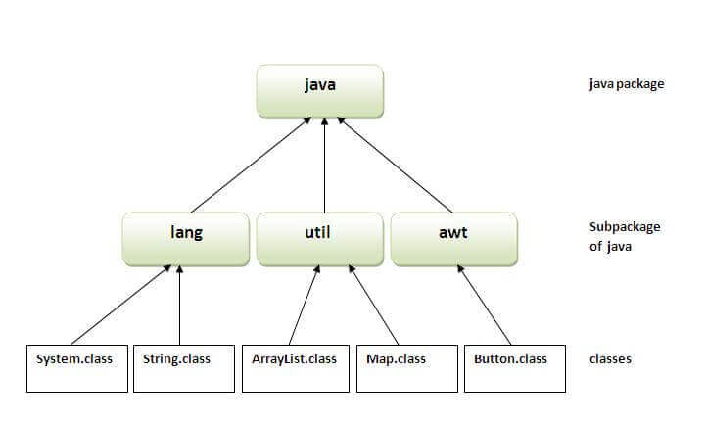
Built in Packages

Slide 9
Examples of Built-in Packages
java.sql: Provides the classes for accessing and processing data stored in a database. Classes like Connection, DriverManager, PreparedStatement, ResultSet, Statement, etc. are part of this package.
java.lang: Contains classes and interfaces that are fundamental to the design of the Java programming language. Classes like String, StringBuffer, System, Math, Integer, etc. are part of this package.
java.util: Contains the collections framework, some internationalization support classes, properties, random number generation classes. Classes like ArrayList, LinkedList, HashMap, Calendar, Date, Time Zone, etc. are part of this package.
java.net: Provides classes for implementing networking applications. Classes like Authenticator, HTTP Cookie, Socket, URL, URLConnection, URLEncoder, URLDecoder, etc. are part of this package.
java.io: Provides classes for system input/output operations. Classes like BufferedReader, BufferedWriter, File, InputStream, OutputStream, PrintStream, Serializable, etc. are part of this package.
java.awt: Contains classes for creating user interfaces and for painting graphics and images. Classes like Button, Color, Event, Font, Graphics, Image, etc. are part of this package.

Slide 10
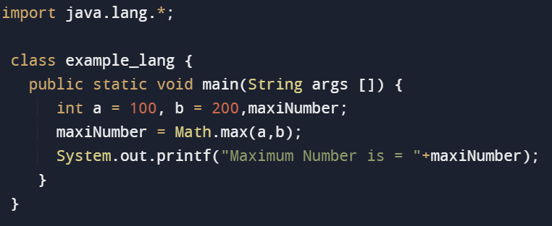
Example of lang Subpackage from java package from

Slide 11
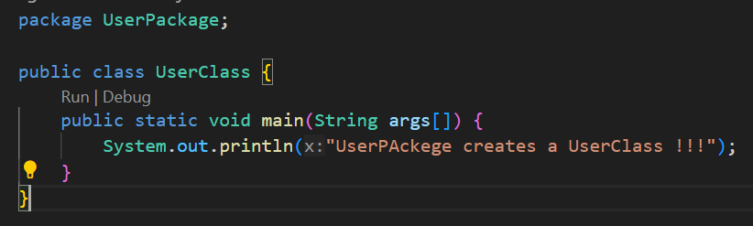
User Defined Package
How to run java package program:
To Compile: javac -d . UserClass.java
To Run: java Userpackage. UserClass

Slide 12
How to access package from another package?
import package.*;
import package.classname;
fully qualified name.
1) Using packagename.*
If you use package.* then all the classes and interfaces of this package will be accessible but not subpackages.
The import keyword is used to make the classes and interface of another package accessible to the current package.

Slide 13
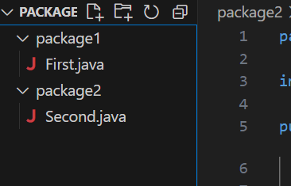
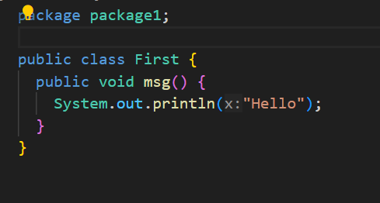
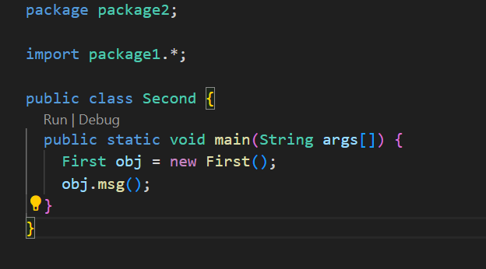
Example of package that import the packagename.*

Slide 14
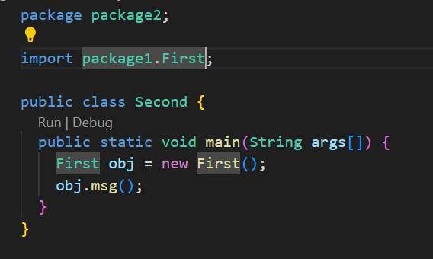
2) Using packagename.classname
If you import package.classname then only declared class of this package will be accessible.

Slide 15
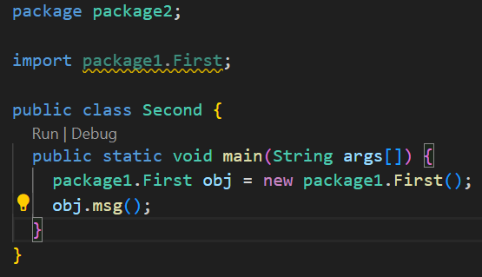
3) Using fully qualified name
If you use fully qualified name then only declared class of this package will be accessible. Now there is no need to import.

Slide 16
There are two ways to load the class files temporary and permanent.
Temporary
By setting the classpath in the command prompt
By -classpath switch
Permanent
By setting the classpath in the environment variables
By creating the jar file, that contains all the class files, and copying the jar file in the jre/lib/ext folder.
There are two ways to load the class files temporary and permanent.

Slide 17
Java Static Import
The static import feature of Java 5 facilitate the java programmer to access any static member of a class directly. There is no need to qualify it by the class name.
Advantage :
Less coding is required if you have access any static member of a class oftenly.
Disadvantage:
If you overuse the static import feature, it makes the program unreadable and unmaintainable.

Slide 18
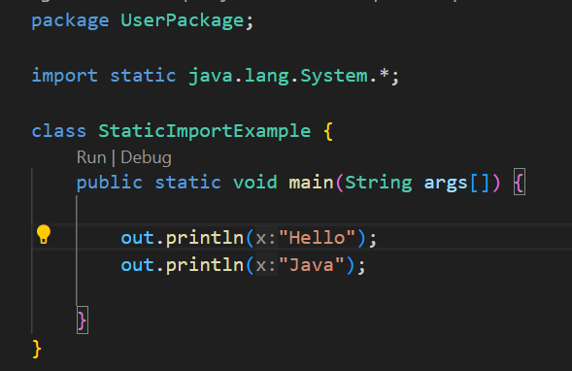
Example of static import

Slide 19
Interface
An interface in Java is a blueprint of a class. It has static constants and abstract methods.
The interface in Java is a mechanism to achieve abstraction. There can be only abstract methods in the Java interface, not method body. It is used to achieve abstraction and multiple inheritance in java.
In other words, you can say that interfaces can have abstract methods and variables. It cannot have a method body.
Java Interface also represents the IS-A relationship.
It cannot be instantiated just like the abstract class.
Since Java 8, we can have default and static methods in an interface.
Since Java 9, we can have private methods in an interface.

Slide 20
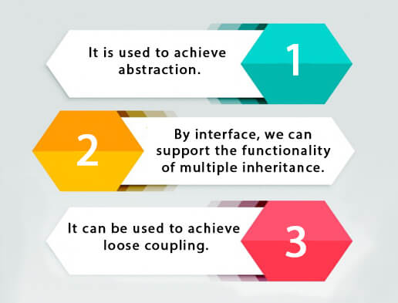
Why use Java interface?
There are mainly three reasons to use interface.

Slide 21
Contents
What is a way declare an interface?
An interface is declared by using the interface keyword. It provides total abstraction; means all the methods in an interface are declared with the empty body, and all the fields are public, static and final by default. A class that implements an interface must implement all the methods declared in the interface.
Syntax for Java Interfaces
interface interfaceName{ // declare constant fields // declare methods that abstract // by default. }

Slide 22
Why use interfaces when we have abstract classes?
The reason is, abstract classes may contain non-final variables, whereas variables in the interface are final, public, and static.
// A simple interface interface Player { final int id = 10; int move(); }

Slide 23
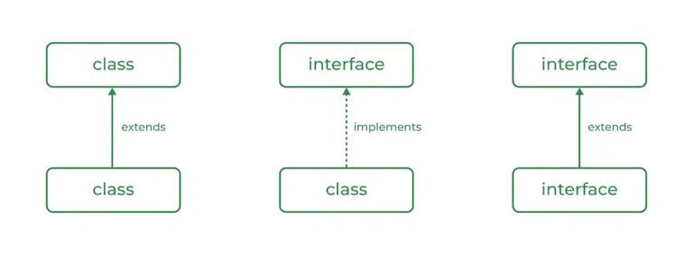
Relationship Between Class and Interface
A class can extend another class similar to this an interface can extend another interface. But only a class can extend to another interface,

Slide 24
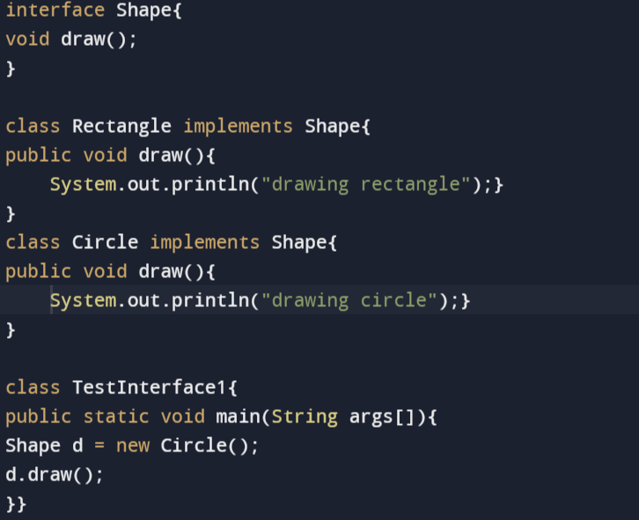
Interface Example: Shape

Slide 25
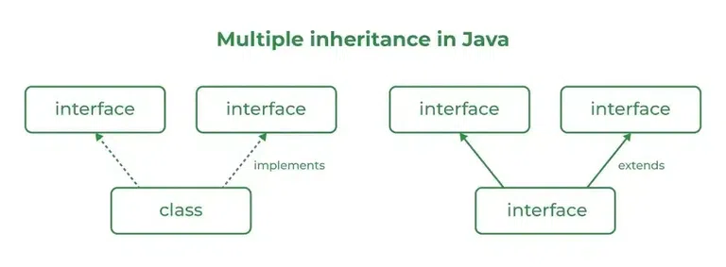
Multiple Inheritance in Java Using Interface
Multiple Inheritance is an OOPs concept that can’t be implemented in Java using classes. But we can use multiple inheritances in Java using Interface.
Implementation: To implement an interface, we use the keyword implements

Slide 26
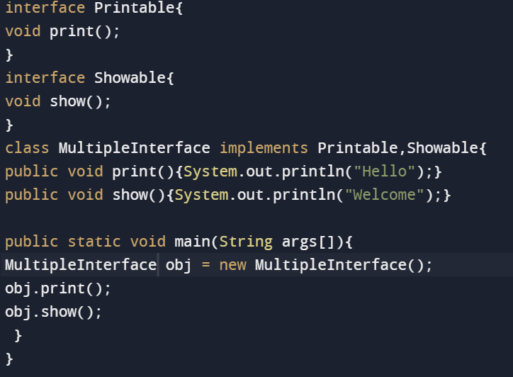
Example of Multiple inheritance by interface

Slide 27
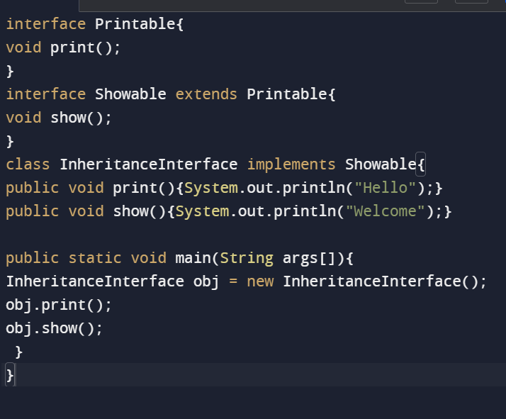
Interface inheritance
A class implements an interface, but one interface extends another interface.

Slide 28
Difference Between Class and Interface
Class | Interface
In class, you can instantiate variables and create an object. | In an interface, you can’t instantiate variables and create an object.
A class can contain concrete (with implementation) methods | The interface cannot contain concrete (with implementation) methods.
The access specifiers used with classes are private, protected, and public. | In Interface only one specifier is used- Public.

Slide 29
Without bothering about the implementation part, we can achieve the security of the implementation. In Java, multiple inheritances are not allowed, however, you can use an interface to make use of it as you can implement more than one interface.
Advantages of Interfaces in Java

Slide 30
How many Types of interfaces in Java?
Functional Interface
An Interface that contains exactly one abstract method is known as functional interface. It can have any number of default, static methods but can contain only one abstract method
Marker interface
Marker or Tagged Interfaces are interfaces without any methods they serve as a marker without any capabilities.

Slide 31
What is Enum in Java?
Enumeration (Enum) in Java was introduced in JDK 1.5.
Most of the other programming languages like C, C++, etc also provide support for enumerations.
Enum is a keyword, a feature which is used to represent a fixed number of well-known values in Java, For example, number of days in a week.
Enum constants are implicitly static and final and you can not change their value once created. In short, enumeration is a list of named constants.
Enum in Java provides type-safety and can be used inside switch statements like int variables.
A Java enumeration is a class type. Although we don’t need to instantiate an enum using new, it has the same capabilities as other classes. Just like classes, you can give them constructors, add instance variables and methods, and even implement interfaces.

Slide 32
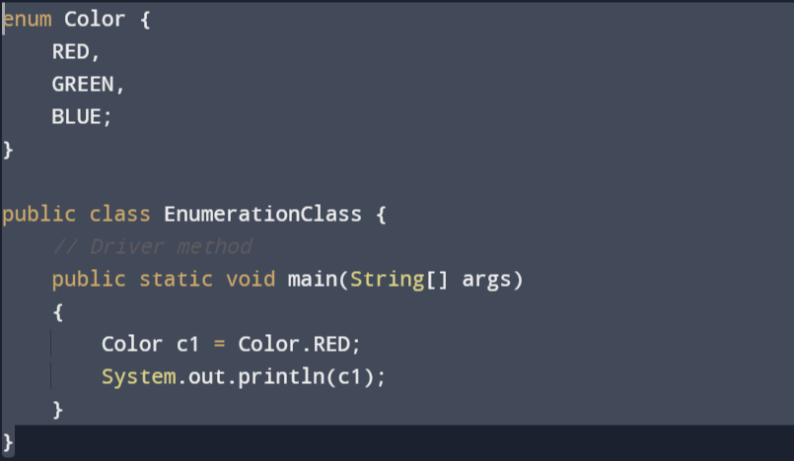
Declaration of enum
Enum declaration can be done outside a Class or inside a Class but not inside a Method.
1. Declaration outside the class

Slide 33
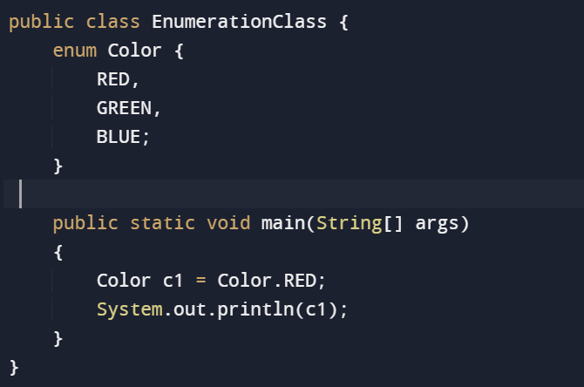
2. Declaration inside a class

Slide 34
There are some Properties of Enum
There are certain properties followed by Enum as mentioned below:
Every enum is internally implemented by using Class.
Every enum constant represents an object of type enum.
Enum type can be passed as an argument to switch statements.
Every enum constant is always implicitly public static final. Since it is static, we can access it by using the enum Name. Since it is final, we can’t create child enums.
We can declare the main() method inside the enum. Hence we can invoke the enum directly from the Command Prompt.

Slide 35
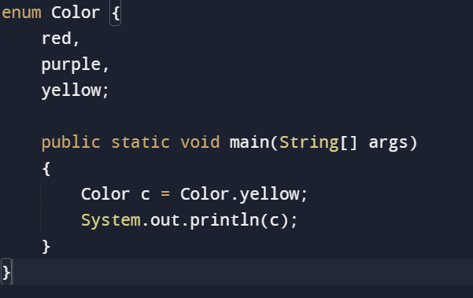
Java Enum Programs
1. Main Function Inside Enum
We can declare a main function inside an enum as we can invoke the enum directly from the Command Prompt.

Slide 36
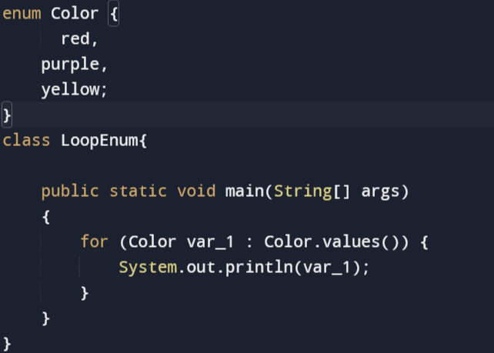
2. Loop through Enum
We can iterate over the Enum using values( ) and loop. values() function returns an array of Enum values as constants using which we can iterate over the values.

Slide 37
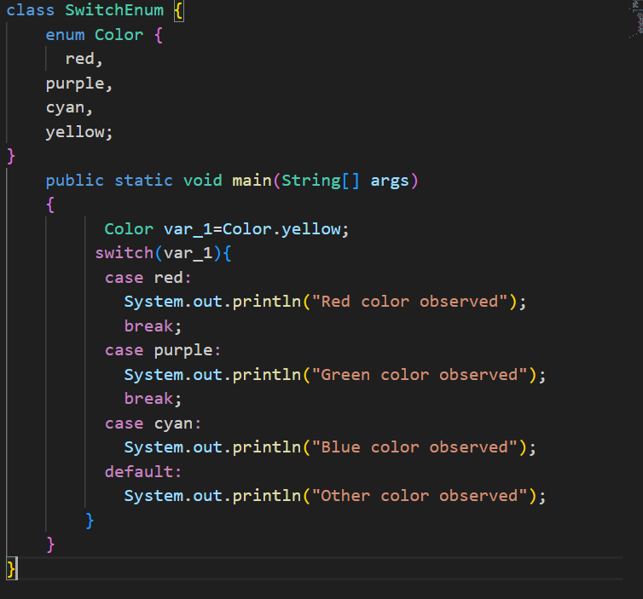
3. Enum in a Switch Statement

Slide 38
There are mainly 3 Methods used in Enum
1.values( ) method In Java, the values( ) method can be used to return all values present inside the enum.
2. valueOf() method
The valueOf() method returns the enum constant of the specified string value if exists.
3. ordinal() method
By using the ordinal() method, each enum constant index can be found, just like an array index.

Slide 39

www.paruluniversity.ac.in

